Slide 1

NATURAL LANGUAGE PROCESSING
Assignment - 03
On the Role of Text Preprocessing In Neural Network Architectures: An Evaluation Study on Text Categorization and Sentiment Analysis
NAME – MAKSUD ALAM
ID – 16201033
COURSE – CSE431(SEC 01)

Slide 2
ABOUT
In this paper, they emphasizes on the txt preprocessing methods for text categorization and sentiment analysis
Here, they investigate the impact of simple text preprocessing decisions
Provides insights into the best preprocessing practices for training word embeddings
Focuses on the role of preprocessing of the input text and it’s affects on the standard neural text classification models (like CNN)

Slide 3
METHODS USED FOR TEXT PREPROCESSING
Tokenizing –given the input text, the tokenization method breaks the input text into a chunk of words.
Lowercasing – it is the simplest preprocessing technique that convert the whole input text into lower case letter. it may negatively impact system’s performance by increasing ambiguity.
Lemmatizing – process of replacing a given token into it’s corresponding lemma.
Multiword grouping – technique that grouped consecutive tokens together into a single token.

Slide 4
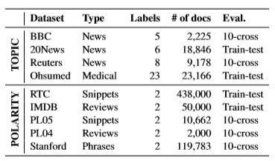
EVALUATION
Here they used two task for the experiments :
Polarity detection
Topic Categori zation

Slide 5
MODELS USED
Here they used two classification models, one is CNN model using ReLU activation function and the second one is LSTM using softmax function.
these models are used for both topic categorization and polarity detection

Slide 6
DATASETS
For the topic categorization task we used the BBC news dataset5 (Greene and Cunningham, 2006), 20News (Lang, 1995), Reuters6 (Lewis et al., 2004) and Ohsumed7. PL04 (Pang and Lee, 2004), PL058 (Pang and Lee, 2005),RTC9,IMDB(Maas et al., 2011)
Topic categorization
the Stanford sentiment dataset10 (Socher et al., 2013, SF) were considered for polarity detection.
Polarity Detection

Slide 7
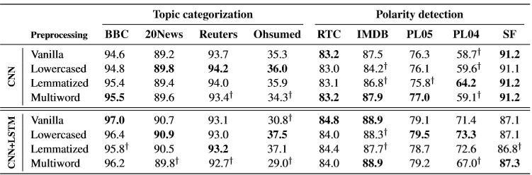
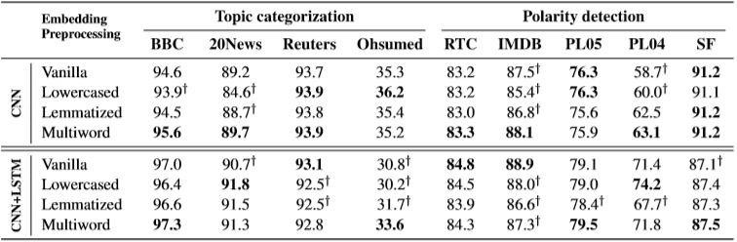
COMPARISON BETWEEN THE TWO EXPERIMENTS
PREPROCESSING EFFECT
CROSS-PREPROCESSING

Slide 8
CONCLUSION
Their evaluations highlighted the importance of being careful in the choice of how to preprocess data and to be consistent when comparing different systems.
Their analysis showed that there is a high variance in the results depending on the preprocessing choice.

